Slide 1

Gender pay report
April 2021

Slide 2
Annual Gender Pay Reporting
Section title
What is the gender pay gap?
It is the difference between women’s and men’s average monthly (full time equivalent) earnings which is expressed a percentage of men’s earnings.
It is different to “equal pay” which looks at pay for men and women who perform the same role.
Why is NGN reporting on its gender pay gap?
Parliament introduced new legislation (Equality Act 2010 Regulations 2017) which requires large employers like ours to publish their Gender Pay information with effect from April 2018.
The report considers direct employees of NGN Limited and NGN Operations Limited. Our calculations follow the guidance set out in the Government legislation.
We commit to publish the report on our external website and on (https://www.gov.uk/report-gender-pay-gap-data ) where it will be available to upload for a period of 3 years.
1

Slide 3
Report as at April 2021
Section title
Gender Pay Gap %
Percentage difference between male and female mean and median pay for the period. Females make up 17.4% of the total workforce.
1

Slide 4
Report as at April 2021
Section title
Gender Bonus Gap %
Difference between male and female mean, and median bonus pay for the period.
72.5% of NGNs females received bonus pay and 73.5% of NGNs males received bonus / incentive pay in the period.
1

Slide 5
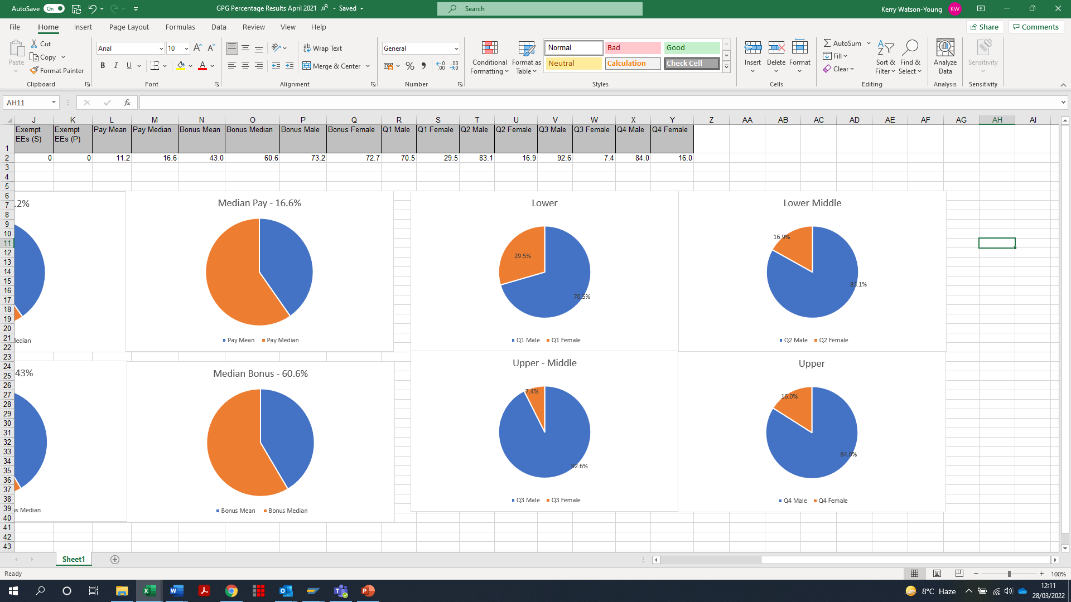
Report as at 5 April 2021
Quartiles %
Proportion of males and females across four equal size
quartiles for the pay period including 5 April 2021.
236 females and 1118 males total 1354 employees.
1

Slide 6
Our story …
Section title
Why do we have a gender pay gap?
The UK’s national gender pay gap is currently 15.4%. NGN’s figure is at 16.6%.
NGN's median Gender Pay Gap for 2021 is 16.6%. This is an increase from April 2020 which was reported at 15.5%.
Whilst we have a workforce made up of 82.6% men and 17.4% women, our business is typical of many others in engineering and has historically attracted a higher percentage of males.
Our analysis shows that there are significantly fewer women in the professional, engineering and senior management levels of the organisation. It is also widely acknowledged that there is a shortage of female students progressing into STEM subjects (Science, Technology, Engineering and Maths) through the formal education system, schools and universities/colleges.
How we are closing the gap?
Although our industry is traditionally perceived as a male dominated one, we are taking a range of actions to try and close the gender gap, and there is more to do. Work is being done through schools engagement to attract more women into our organisation. We have reviewed our recruitment practices and continue to seek best practice in our approach to recruitment. This includes working with external organisations such as the Equal group and BITC
We have established a number of colleague communities including a women's group, which is focussed on understanding the needs of our female colleagues and actions required to ensure we engage and retain them.
We continue to provide generous family friendly policies including paid keeping in touch days, six months full maternity pay, and a flexible working policy to encourage more women to join NGN and stay with us. The introduction of formal hybrid working arrangements has benefitted colleagues with commitments outside of work and is seen as a key retention tool.
We have seen a small increase to our pay gap from 2020 which comes as a result of organisational changes.
1

Slide 7

Declaration
Section title
I confirm that the data contained in this report has been generated by NGN systems; checked and validated as accurate and fully audited.
Mark Horsley, CEO, Northern Gas Networks
Northern Gas Networks Limited
Registered Office No. 5167070
Thorpe Park Business Park, Colton, Leeds, LS15 8TU
www.northerngasnetworks.co.uk
1

